Slide 1

ENERGY CONSUMPTION ANALYSIS
  BY
  Santhosh.M
  Vinay.M
  Vasanth.N.V.S

Slide 2
Objective of the Project:
The main objective of this project is to understand global energy and environmental patterns by creating and analyzing a complete SQL database.The project focuses on organizing data related to countries, emissions, energy production, energy consumption, GDP, and population in a structured and relational format.
Through SQL queries, the project examines how different countries produce and consume energy, how emissions change over time, how population growth impacts the environment, and how economic factors like GDP relate to energy usage.
The goal is to turn raw global data into meaningful insights that help evaluate environmental performance, compare countries, and support better decision-making in sustainability and energy management.

Slide 3
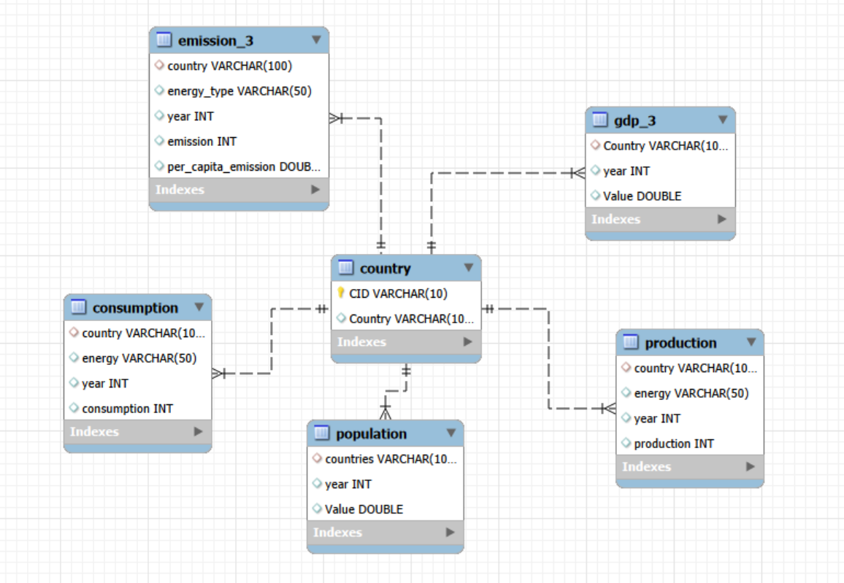
ER Diagram

Slide 4
Schema Explanation
country (1) → (many) emission
country (1) → (many) population
country (1) → (many) production
country (1) → (many) consumption
country (1) → (many) gdp
Each country acts as a master record that connects to multiple rows in the emission, population, production, consumption, and gdp tables through a foreign key (for example, country_id). This design creates a one‑to‑many relationship where one country can have many related records for emissions, population, energy production and consumption, and GDP over time, enabling multi-year, multi-country analysis of energy and economic trends.

Slide 5
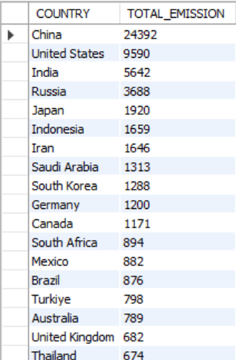
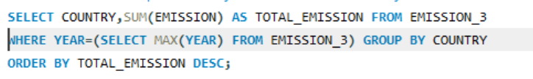
Key analysis questions (use cases)
Total emission per country for the most recent year available

Slide 6
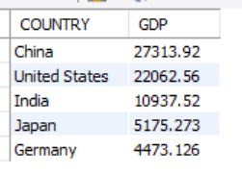

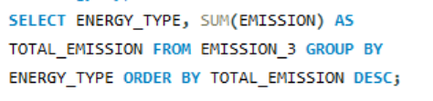
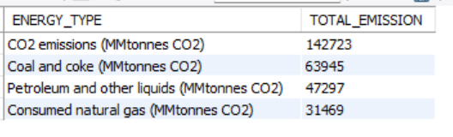
Top 5 countries by GDP in the most recent year
Energy types that contributed most to emissions across all countries

Slide 7
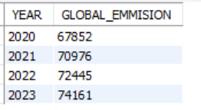

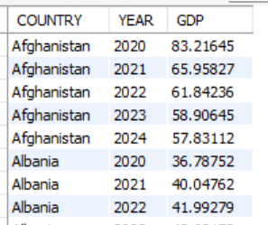

Change in global emissions over the years
Trend in GDP for each country over the given years

Slide 8
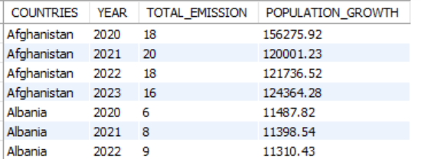
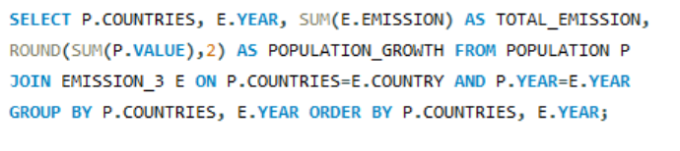
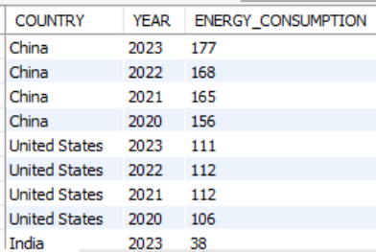
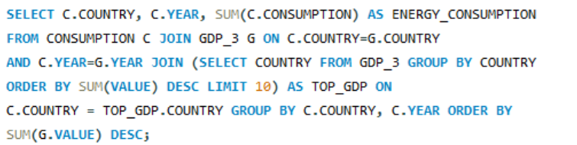
Change in total emissions in each country by population growth
Change in energy consumption over the years for major economies

Slide 9
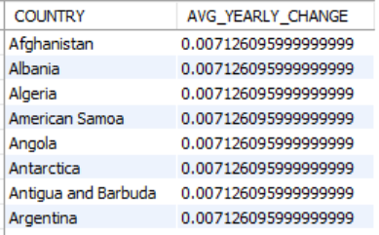

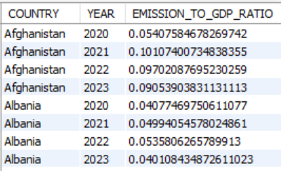
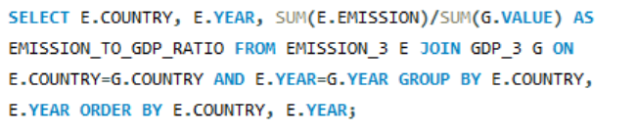
Average yearly change in emissions per capita for each country
Emission-to-GDP ratio for each country by year

Slide 10
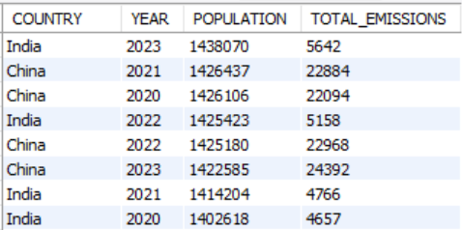
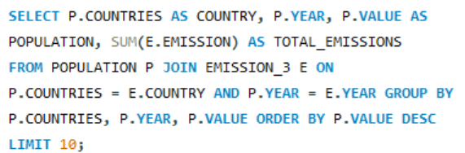
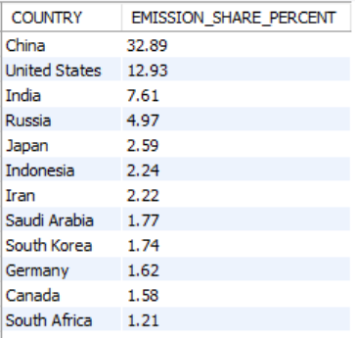
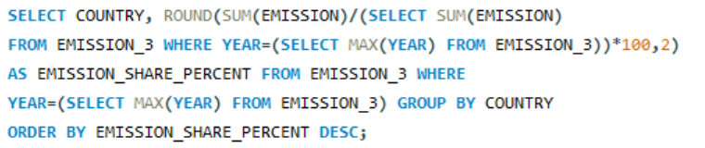
Top 10 countries by population and their respective emissions
Global share (%) of emissions by country

Slide 11
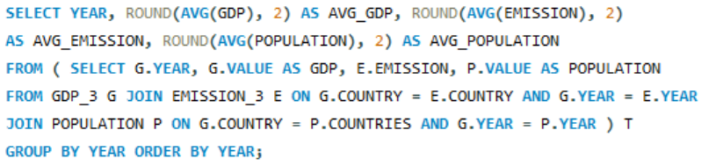
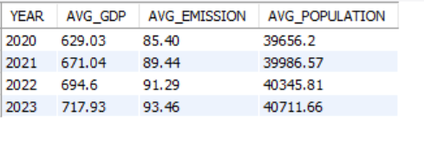
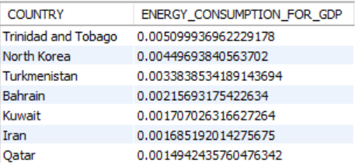
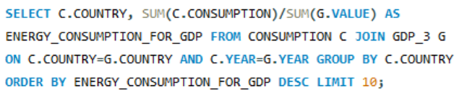
Global average GDP, Emission and Population by year
Countries with highest Energy Consumption for their relative GDP

Slide 12
Key Insights From the Energy & Emissions SQL Analysis
The database organizes global data on emissions, energy production, consumption, GDP, and population for each country.
SQL queries help analyze global trends, such as rising or falling emissions and energy usage patterns.
The project shows how energy types, economic growth, and population influence a country’s environmental impact.
High-emission countries and energy types contributing most to pollution are easily identified through aggregated queries.
The overall analysis supports better sustainability decisions, highlighting the need for clean energy, efficient use of resources, and balanced economic development.

Slide 13
Conclusion:
This project creates a comprehensive SQL database to study global patterns in emissions, energy production and use, GDP, and population. By organizing the data into structured tables and running analytical queries, it highlights insights such as which countries are the largest emitters, how energy consumption connects to economic growth, and how population levels influence environmental pressure. These insights transform raw data into practical evidence that can guide more sustainable planning and better-informed policy decisions.

Slide 14

THANK YOU

